Slide 1
Chapter 7
Waves

Slide 2
Lesson Key terms
Periodic motion
Period
Frequency
Vibration
Oscillation
amplitude

Slide 3
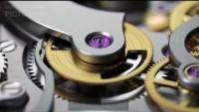

Slide 4
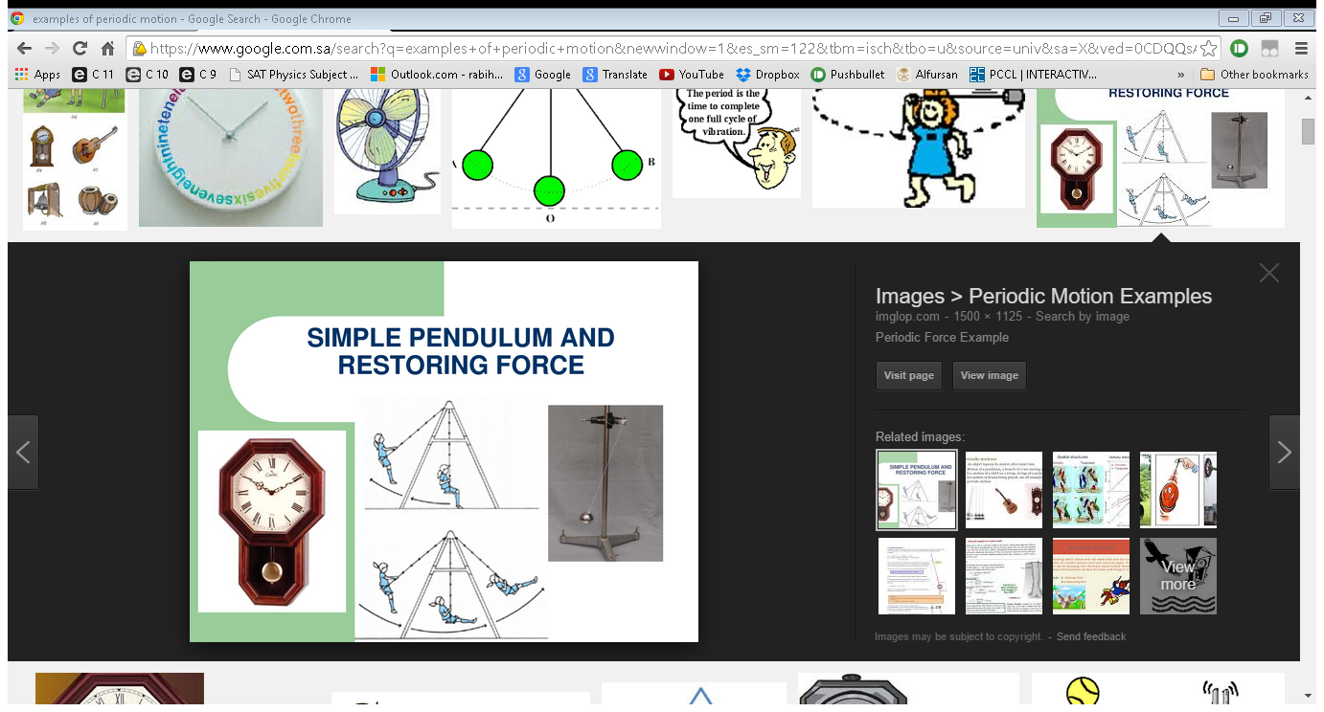
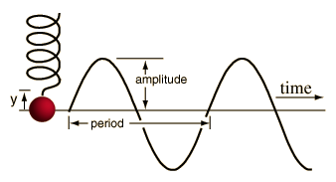
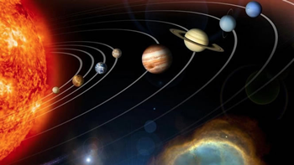
Periodic Motion
Repeated motions in equal time intervals, such as those made by:
  a child on a playground swing,
  or the pendulum of a grandfather clock,
  Earth in its orbit around the Sun,
  and wave movement are called a periodic motion.

Slide 5
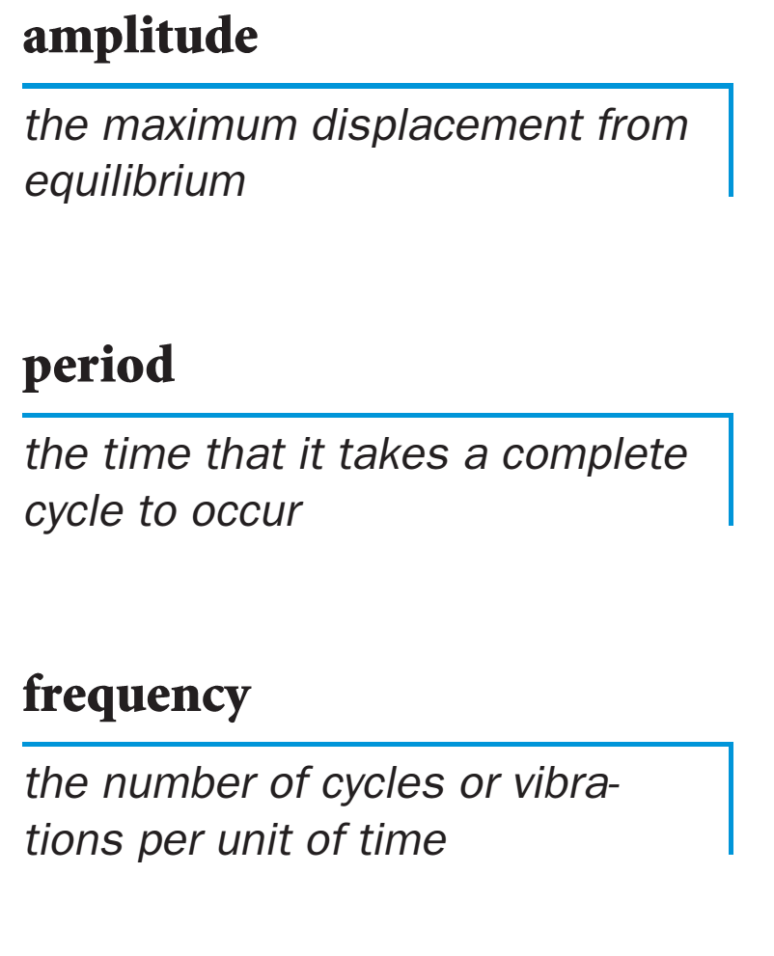
PERIOD

Slide 6
PERIOD
Note:
Period is a time interval so its si unit is seconds (s).

Slide 7
FREQUENCY

Slide 8
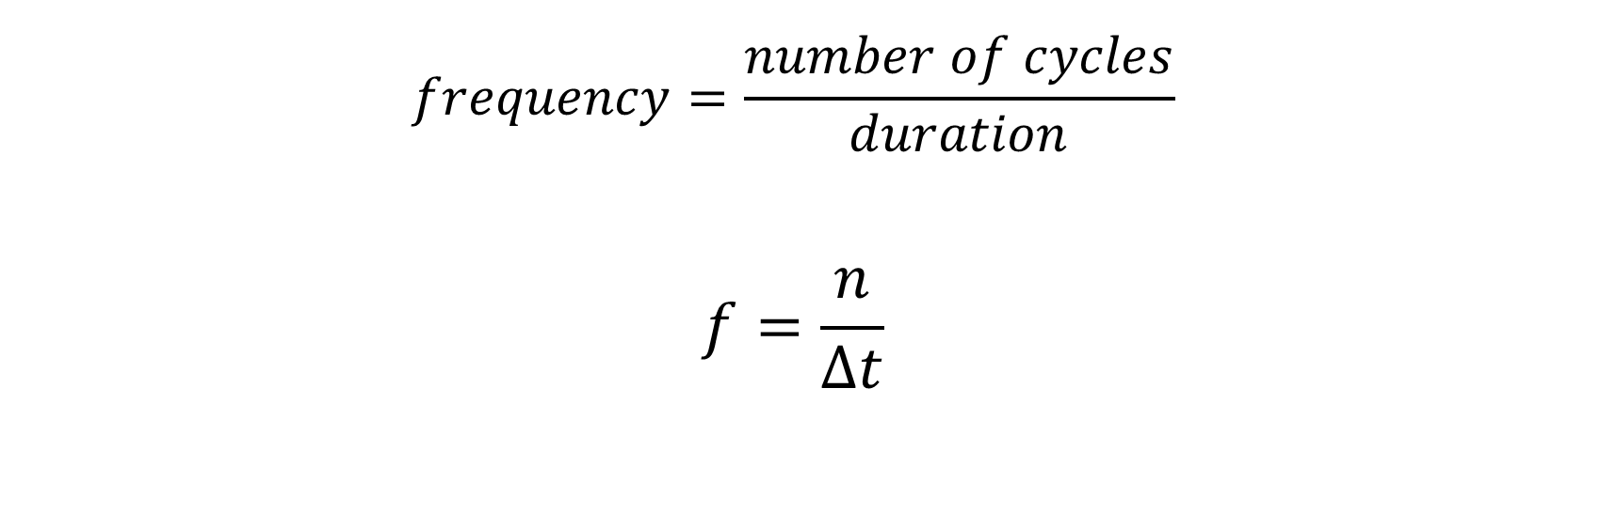
FREQUENCY
$$frequency=\frac{number of cycles}{duration}$$
$$f=\frac{n}{∆t}$$
In SI units frequency is expressed in hertz (Hz).

Slide 9
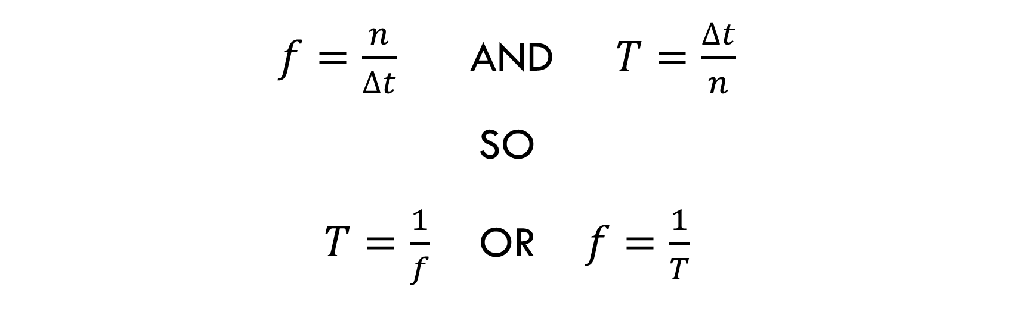
Link between frequency & period
$f=\frac{n}{∆t}$ and $T=\frac{∆t}{n}$
So
$T=\frac{1}{f}$ Or $f=\frac{1}{T}$

Slide 10
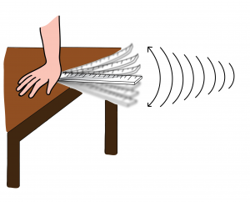
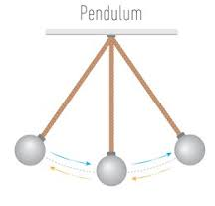
Vibrations or oscillations

Slide 11
Vibrations or oscillations
vibrations or oscillations are repeated back and forth or up and down motion.
Examples are:
  old clock pendulum,
  child on a swing,
  mass on spring bouncing up and down.

Slide 12
Amplitude of a vibration or oscillation
Amplitude is the maximum displacement away from the rest or equilibrium position.

Slide 13
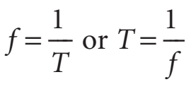
AMPLITUDE, PERIOD, AND FREQUENCY

Slide 14

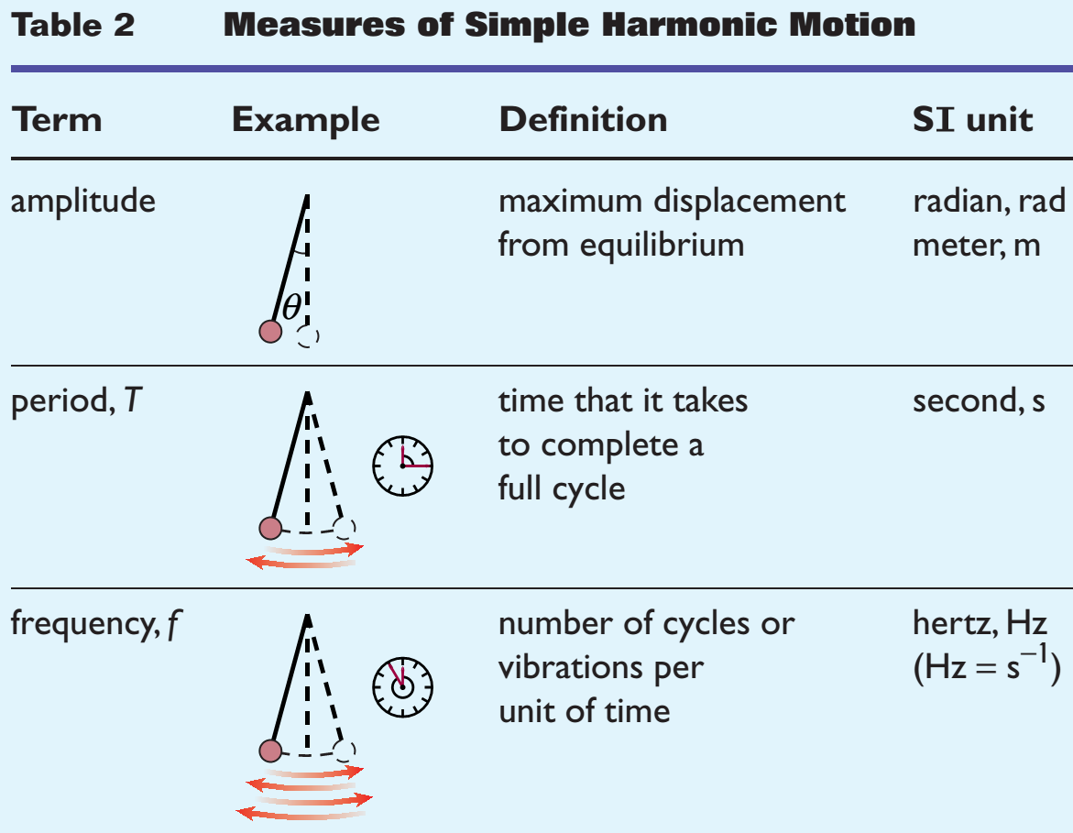

Slide 15
